Slide 1
Transition of Care
Case Study: Billing Opportunities

Slide 3
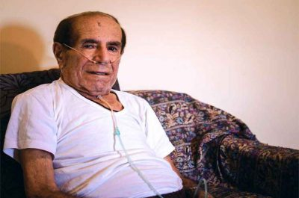

Mr. Smith is on the Admission Discharge Transition list this morning.
Admission date: 3 days ago.
Discharge date: Yesterday
Diagnosis:
Admitting diagnosis: Hypoxia, Shortness of Breath
Discharge diagnosis: Hypoxia, COPD
Mr. Smith has not been in care management services prior to this admission – discharge.

Slide 4
Based on the diagnosis, who on your team will be responsible for completing a post-discharge call with Mr. Smith?
What should be done prior to using a billing code for this call?
How did your team come to that decision?
Notes:
Answers to 1 will vary based on the team compensation.
Answer to 2: Review the post-discharge instructions – determine if there should be a discussion with the provider before calling Mr. Smith.
Answer 2 – verify benefits – see next slide

Slide 5
Checking the Provider Delivered Care Management Benefit in Availity
How do I check that the patient has PDCM Provider Delivered Care Management (PDCM) benefits?
You can check that a patient has PDCM benefits through the Availity portal.
Select Eligibility and Benefits Inquiry
Enter information on the doctor and the patient
Select Benefit Information and expand the category
Scroll down to Physician Visit Office Well
Select Physician Visit Office Well Additional Details
Look for the following statement: This member’s group allows coverage for provider delivered care management and total care.
If this statement is present, the member has PDCM benefits. If this statement is not present, the member does not have PDCM benefits. Please note, the benefit information can be found in multiple sections on Availity, as anything relating to medical care will feed into different categories.

Slide 6
Transition of Care
Case Study – Billing: Completing the Call
Outreaching to Mr. Smith to complete a follow up and safety check from his hospitalization
The call | The team member reaches Mr. Smith at his home. Shares they are calling from the office (this could be a specialist or primary care provider office).
The goal | The team member shares they are calling to see how things are going, answer any questions and make sure he has everything he needs to be safe at home.
What is the primary goal of completing a post-discharge call?
What key information would be helpful in meeting that goal?
Notes:
Answer 1: Mitigate risk and safety to prevent an unnecessary ER or additional hospital admission.
Answer 2: Medications taking, equipment, ability to complete ADL’s and or assistance to help, any questions Mr. Smith may have.

Slide 7
Transition of Care
Case Study – Billing: Completing the Call
The workflow in this practice is having the population health team complete the first call to make sure Mr. Jones has the follow up appointments on his schedule and he has transportation to get to the appointments.
Are there any billing codes that could be submitted at this time?
How did you come up with your answer?
This team includes medical assistance and community health workers
The team has a list of “red flag” triggers to identify potential risks
If a patient has a “red flag” the call is transferred to a licensed care team member to follow up with the patient. The expectation is the call will be completed before end of day.

Slide 8
Patient Centered Medical Home Capacity
13.0 Care Coordination
13.0 Coordination of Care
Goal: Patient transitions are well-managed and patient care is coordinated across health care settings through a process of active communication and collaboration among providers, patients and their caregivers.
13.1 – Required (as of 2021)
For patient population selected for initial focus, mechanism is established for being notified of each patient admit and discharge or other type of encounter, at facilities with which the physician has admitting privileges or other ongoing relationships.
13.2
Process is in place for exchanging necessary medical records and discussing continued care arrangements with other providers, including facilities, for patient population selected for initial focus
13.4
Process is in place to systematically flag for immediate attention any patient issue that indicates a potentially time-sensitive health issue for patient population selected for initial focus
13.7
Practice has written procedures and/or guidelines on care coordination processes, and appropriate members of care team are trained on care coordination processes and have clearly defined roles within that process

Slide 9
Transition of Care
Case Study – Billing: Follow up from a Licensed Team Member
Findings from the post-discharge call:
Mr. Smith’s condition | Mr. Smith reports: He is still a little short of breath He couldn’t afford the prescription the hospitalist gave him, so he did not pick it up.
MA | The MA identifies actions on the practice “Red Flag” trigger list: Symptoms of shortness of breath Not picking up prescribed medications
Actions | Review the medication prescribed that was not picked up. Transfer the call the nurse care manager for further evaluation
Triage nurse | The nurse care manager reviews: Medication prescribed and will have the provider determine if there is an alternative that is covered by Mr. Smith’s health insurance. She will call Mr. Smith back today with the decision. If a new prescription is order, verify Mr. Smith can have someone pick it up for him today. Notes Mr. Smith is schedule for an appointment with the Nurse Practitioner tomorrow morning. Confirms Mr. Smith is planning to attend the appointment and that he has transportation to get to the appointment.
Notes:
Post-discharge call and follow up – can use one of the telephone codes 98966, 67, 68. The amount of time on the call with Mr. Smith would determine which code would be used. Applies to both BCBSM/BCN and PH.

Slide 10
Patient Centered Medical Home Capability
3.0 Performance Reporting and 13.0 Coordination of Care
3.21
Performance reports are generated for the population of patients with: concerns related to social determinants of health, such as transportation limitations, housing instability, interpersonal violence, or food insecurity
3.24
Performance reports are generated for the population of patients with: Chronic Obstructive Pulmonary Disease (COPD)
  The practice must demo how they are using these performance reports to improve population management.
  Are the relevant measures included in the performance reports?
  What sort of review is being done with these reports?
  What actions are taken?
13.10
Following hospital discharge, a tracking method is in place to apply the practice’s defined hospital discharge follow-up criteria, and those patients who are eligible receive individualized transition of care phone call or face-to-face visit within 24-48 hours

Slide 11

Transition of Care
Are there any billing codes that could be submitted at this time?
How did you come up with your answer?

Slide 12
Transition of Care
Post-discharge follow up in the office
Prior to the provider appointment | Using SBAR, the nurse care manager shared updated the provider of Mr. Smith’s status: Situation Discharge 2 days ago from an exacerbation of his COPD Symptoms worsening Did not pick up his prescription – new antibiotic prescribed and he took the first dose last night Background Lives along Unable to drive Can care for himself/complete ADL’s Assessment Shortness of breath less than it appeared on the call yesterday If stable and returning to home Recommendations Refer to care management services for regular follow up and monitoring until stable
NP Visit | The nurse practitioner completes an assessment and evaluation: Reviews the team-based care approach at the office and recommends Mr. Smith enroll in care management with the nurse at the office.
Nurse care manager | Following the visit with the NP, the nurse CM’er meets with Mr. Smith: Reviews the role and what to expect from the nurse care manager. Reviews potential cost, together they make a call and confirm the service is covered. Completes a safety check and education on antibiotic use. Schedules a follow up call in 2 days.
Billing | In-person visit, no assessment by the nurse care manager.
Notes:
G9002 – in-person visit. No assessment components completed yet.
G9001 – if the information will be part of the assessment. There will need to be a follow up call or visit to complete the assessment. When the assessment is done, the code would be submitted for payment.

Slide 13

Transition of Care – Office visit
Are there any billing codes that could be submitted at this time?
How did you come up with your answer?
Notes:
G9002 – in-person visit. No assessment components completed yet.
G9001 – if the information will be part of the assessment. There will need to be a follow up call or visit to complete the assessment. When the assessment is done, the code would be submitted for payment.

Slide 14
Transition of Care
Case Study – Billing: Follow Up Call
Telephone follow up call from the nurse care manager to Mr. Smith
Care Manager | Calls Mr. Smith and reviews the following: Safety check on symptoms, medication review and care needs Starts the assessment by reviewing his behavioral, medical and social needs, past treatment and response to treatment recommendations. Review of his current treatment plan related to the COPD hospitalization Confirms his upcoming follow up visit with the provider and ability to get there.
Mr. Smith | Mr. Smith provides the following information: He is taking his antibiotic – no problems He does have the appointment but will need assistance with transportation. His son works fulltime and will not be able to take off from work again. He used up his vacation time for the last visit, when he brought Mr. Smith in.
Actions | Nurse care manager: Will send a ticket in to the referral coordinator to arrange transportation. Mr. Smith will hear from her within the next 2 days. The total time for the call with the nurse care manager and Mr. Smith was 35 minutes. Referral coordinator: Arranges transportation with the VA The total time of the call is 10 minutes Calls Mr. Smith with the arrangements. Total time of the call is 5 minutes

Slide 15
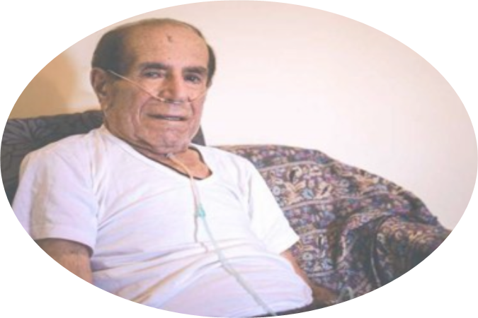
Transition of Care: Follow up and Monitoring
Are there any billing codes that could be submitted at this time?
How did you come up with your answer?
Notes:
Nurse care manager can use the total minutes towards the assessment. For BCBSM/BCN, there are no specified time requirements. For PH, the assessment must take at least 30 minutes.
The referral coordinator can document the minutes used for the call with the transportation company. If 31 minutes are accrued at the end of the month, they can be submitted under the care coordination code to BCBSM/BCN. For PH, the total minutes must be at 60 minutes minimum.

Slide 16
Transition of Care
Second follow up appointment post-hospitalization
Mr. Smith | Mr. Smith comes into for his scheduled appointment: The transportation agency picked him up and is waiting for him to transport him home. He meets with the provider He reports he is going to need oxygen tank, and doesn’t know how to do that. He will need transportation to the pulmonologist visit that is scheduled next week.
Provider | After the provider completes her assessment and evaluation, she sends a note to the referral coordinator to arrange for the transportation and oxygen delivery.
Care manager | After the visit with the NP, the nurse care manager meets with Mr. Smith: Reviews the referral coordinator is making arrangement for the transportation and oxygen. Completes the CM assessment and develops a care plan with Mr. Smith. She let’s Mr. Smith know she will review the plan with the NP. If there are any changes, she will call Mr. Smith with the updates.
Referral Coordinator | The referral coordinator: Calls the transportation agency and arranges transportation to the pulmonologist. Calls the Oxygen supplier and arranges regularly scheduled delivery.
Billing | The nurse care manager completed the assessment, care plan and plans to review with the provider. The referral nurse spent 10 minutes with the transportation agency. The referral nurse spent 15 minutes with the oxygen supplier. The referral nurse reviewed the plans with Mr. Smith prior to leaving the office. This took 15 minutes.

Slide 17
Patient Centered Medical Home Capability
3.21
Performance reports are generated for the population of patients with: concerns related to social determinants of health, such as transportation limitations, housing instability, interpersonal violence, or food insecurity
3.24
Performance reports are generated for the population of patients with: Chronic Obstructive Pulmonary Disease (COPD)
  The practice must demo how they are using these performance reports to improve population management.
  Are the relevant measures included in the performance reports?
  What sort of review is being done with these reports?
  What actions are taken?

Slide 18
Transition of Care – Office visit
Are there any billing codes that could be submitted at this time?
How did you come up with your answer?
Notes:
G9001 – The nurse care manager completed the assessment.
Provider – E and M code
Referral coordinator: Can add the minutes to the previous minutes used. If total for the month is over 30 minutes, they can bill BCBSM/BCN. If 60 minutes or more – can bill PH.

Slide 19
Transition of Care
Case Study – Billing: Follow up and Monitoring
The care manager has regular follow up calls with Mr. Smith. During each call, she completes a safety check and works with Mr. Smith to empower him in self-managing.
What codes can be used for these follow up and monitoring phone calls?
What code could be used if Mr. Smith came into the office for the follow up?
How did you come to this decision?
Notes:
Pending on the amount of time spent with Mr. Smith on the calls a 98966 – 67 -68 code can be billed.
If Mr. Smith came into the office and a follow up visit was completed by the nurse CM, a G9002 code could be billed.

Slide 20
Transition of Care
Case Study – Billing: Closure
Case closure discussion and decision
Care manager | The nurse care manager: Reviews the stutus of Mr. Smith and the progress he has made with the NP. She reports Mr. Smith understands his diagnosis and has a good handle on what to do when he starts experiencing and how to prevent an exacerbation to include managing: Fever Shortness of breath Pacing himself to conserve energy
Provider | Based on the CM report, the provider agrees it is appropriate for the CM to discharge Mr. Smith from her services
Mr. Smith | During the call with the nurse CM, Mr. Smith feels confident in his self-management and agrees he can manage on his own.
Billing | The CM and provider discussed the case. The CM’er completing a 25-minute call with Mr. Smith

Slide 21
Day In the Life
Use of the ADT to Identify Patients for PDCM
Start each day with reviewing the ADT report for individuals who will require a post-discharge call. This is based on the practices protocol/policy.
Review the list with the provider or using a standing order prepare to outreach to the identified individuals. Have available the discharge instructions to review with the patient.
After the call, complete the documentation.
Review patients who may benefit from PDCM with the care team.
Verify PDCM benefits with the patient’s health insurance employer plan.
Using the practice protocol complete the referral to the PDCM team member.

