Slide 1
Section 3
The Process of CoCM
Notes:
Presenter: Sue Vos

Slide 2
The Process of CoCM
Targets: Defining Improvement
Validated Outcome Measures:
  PHQ-9 (Patient Health Questionnaire)—Depression screening
  GAD-7 (Generalized Anxiety Disorder)—Anxiety screening
Improvement:
  5-point reduction in score = Improvement
  50% reduction in score = Response
  Score less than 5 = Remission
Tracking PHQ-9 score data is required for CoCM service delivery.
Tracking GAD-7 score data is highly recommended but not required.
Notes:
Presenter: Sue

Slide 3
The Process of CoCM
Steps of CoCM
Patient Identification, Referral, and Appropriateness Assessment | Intake Assessment and Engagement | Systematic Case Review and Psychiatric Consultation | Initiating and Adjusting Evidence-based Treatments (Treat to Target) | Systematic Follow up -Tracking Treatment Outcomes | Completing Treatment and Relapse Prevention
Program oversight and quality improvement

Slide 4
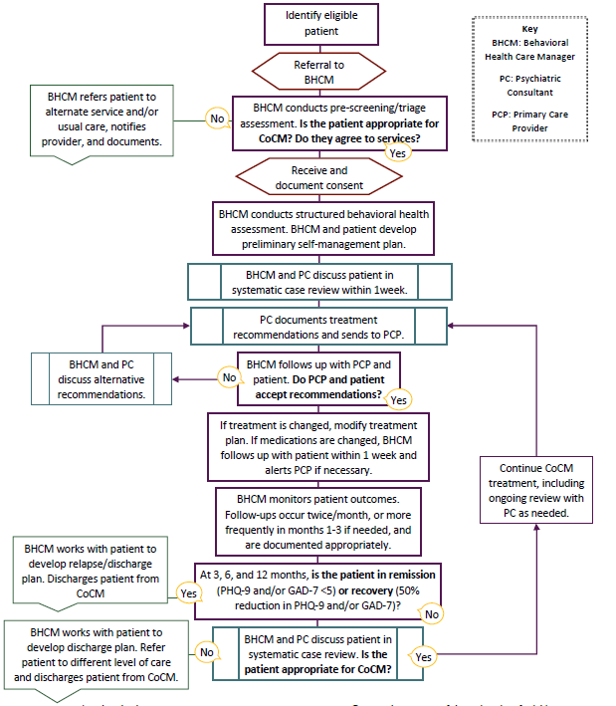


The Process of CoCM
PDF located on the MICMT Website
8/16/2022
This document contains confidential and proprietary information. Any further copying, reproduction, or distribution without express written consent of presenters is strictly prohibited.
4
Notes:
Presenter: Sue

Slide 5
The Process of CoCM
Identifying Patients
Screening/Referrals
  Diagnosis of depression and/or anxiety
  PHQ-9 and/or GAD-7 of 10+
Additional Avenues May Trigger Screening
  New or changed dose of psychotropic medication
  Patient not responding to psychiatric medication
  Self-report (depression/anxiety symptoms)
Patient Finding
  A disease registry can be used to identify patients eligible for CoCM services
Patients who may not be appropriate candidates:
  Currently under the care of a psychiatrist
  Currently involved with Community Mental Health
Notes:
Presenter: Sue

Slide 6
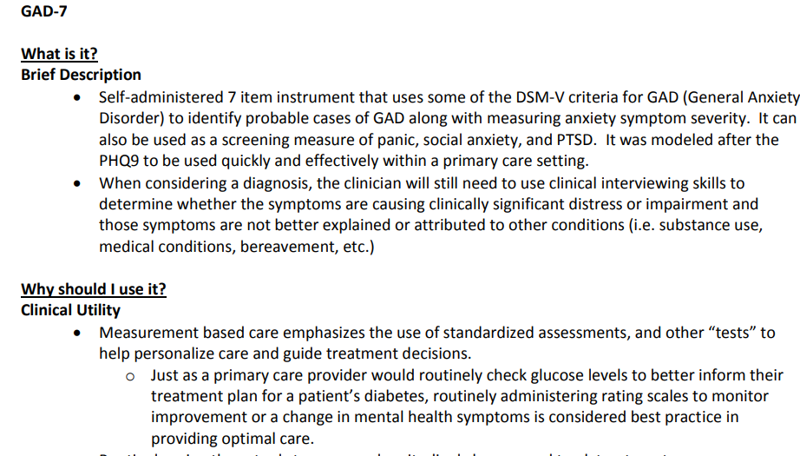
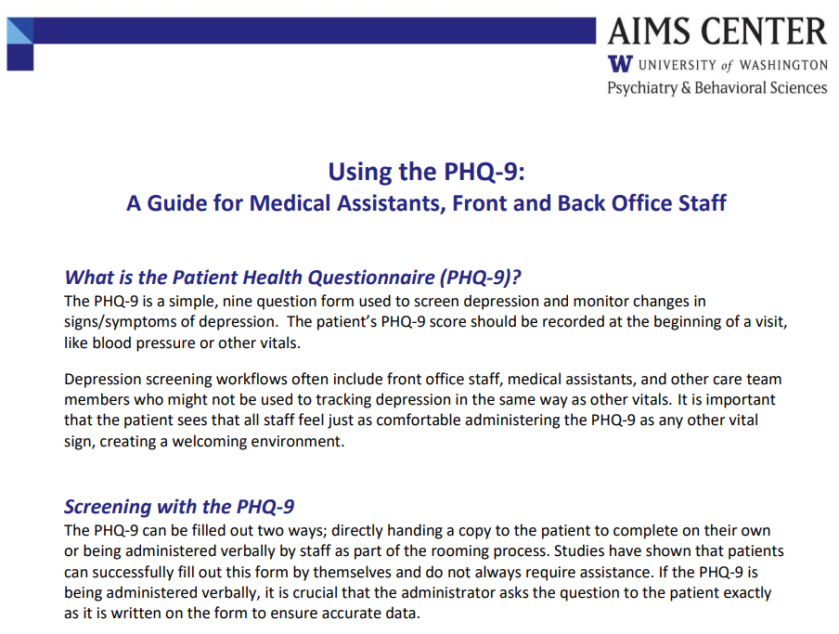
The Process of CoCM
Screening and Measurement-Based Care Tools
GAD-7: Administration Guide from VA
PHQ-9: https://aims.uw.edu/resource-library/help-clinic-staff-talk-patients-about-phq-9
Notes:
Presenter: Sue

Slide 7
8/16/2022
This document contains confidential and proprietary information. Any further copying, reproduction, or distribution without express written consent of presenters is strictly prohibited.
7
Notes:
Sue asks for input from Mark Williams.

Slide 8

Patient Identification During the Visit
Janice Banco
Janice presents to the clinic for her annual wellness visit. Part of the visit will include depression screening.
As part of the planned visit, the office mailed Janice the PHQ9 form and asked her to bring it along to the visit. Janice hands in the form when she registers at the front desk.
The front desk team member clips the form onto the MA’s clipboard. The MA opens Janice record and enters the results into the EMR flowchart.
The MA then sends an instant message to the provider informing her the results have been entered, and the score is above 10.
Notes:
Presenter: Sue

Slide 9
The Process of CoCM
Considerations for Screening
When will screening happen?
  Annually, every visit
  More often for unique circumstances (risk factors, other health conditions, life events, discharged from hospital, etc.)
Where will screening happen?
  Waiting room, triage, exam room, patient portal
How and when will screening happen?
  Paper form
  Verbally
  Pre-planning visit prep
How will results get communicated to the provider?
  Through EHR
  Verbally
Poll: How is screening happening in your practice?
Notes:
Presenter: Sue
Poll name: Screening Tool Familiarity

Slide 10

Disease Registry:
“In brief, a patient registry is a collection—for one or more purposes—of standardized information about a group of patients who share a condition or experience. The use of “patient” in patient registries is often used to distinguish the focus of the data set on health information”
Patient Identification Using the Registry
Rob Billinger
It’s been 18 months since Rob’s last clinic visit. Rob, a veteran, has a history of depressive episodes post-discharge, and has received treatment with medications and therapy a couple of times in the last 5 years.
The population health manager obtains the Disease Registry Report and notices Bob hasn’t had a PHQ in the last 12 months. He is 6 months overdue.
All patients have an annual screening and when a diagnosis of depression is identified, the date of completion and the score is entered into the registry in this clinic.
All quality metric scores are reported out every quarter, this includes the score and date of the last PHQ.
https://www.ncbi.nlm.nih.gov/books/NBK164514/
Notes:
Presenter: Sue

Slide 11
The Process of CoCM
Disease Registry
A population health registry that tracks referrals and enrollment for patients with diagnosis of/or screened positive for depression/anxiety
All screened patients should be added to the registry
Excellent tool for case finding
Data gathering tool
  Mandatory for BCBSM
Notes:
Presenter: Sue

Slide 12
The Process of CoCM
Building CoCM into Standard Work
Determine or identify a standard.
Identifying areas where best practices are either non-existent or inadequate.
Establish consensus around the proposed standard.
Once you’ve defined the standard, communicate that information to the rest of the team. The goal is to ensure that everyone understands what that standard is and how it stands to improve processes. Additionally, everyone needs to commit to following the standard.
Confirm that the standard is reasonable and easy to follow.
Evaluate the proposed standard to determine whether it’s reasonable, fair, and can be followed. For example, you may need to make improvements to the standard to clarify what’s expected at each step or to streamline a specific task.
https://www.gembaacademy.com/resources/gemba-glossary/standard-work#:~:text=Standard%20Work%20is%20the%20practice,and%20the%20foundation%20for%20Kaizen.
Notes:
Presenter: Sue
Standard defines what will be done. Workflows are generally an output/picture of the standard work.

Slide 13
The Process of CoCM
Standard Work - Application to CoCM
Who will provide the screening tool? Who will document the results?
How will referrals to the BHCM be communicated in your workflow?
Building CoCM into current workflows, resources, channels of communication
Documentation and Tracking
  Document and report on how many patients referred and how many accepted/declined
  Of those who declined, what was the reason? (SCR tool standard measurement)
Notes:
Presenter: Sue

Slide 14

The Process of CoCM
Managing Patients Benefiting from Higher Level of Care
Patients with:
  Severe substance use disorders
  Active psychosis
  Significant developmental disabilities
  Personality disorders requiring long-term specialty care
  Cognitive deficits
  Symptoms due to medical condition
**Currently receiving Community Mental Health or better served by CMH-level services.
Notes:
Presenter: Mark Williams

Slide 15


Acute Safety Concern Patient
Ginny Bell
Ginny is enrolled into CoCM and is in today after starting new medications for depression.
The MA notes in the medical record the BHCM’er completed a PHQ-9 (3 weeks ago). As it’s been over 2 weeks since a screening was done, the MA has Ginny complete a paper PHQ-9 today.
Ginny: I just did this with Chris a couple of weeks ago. Do I really need to do this again?
MA: Your provider wants to know more about your overall health so that we can properly gauge if the treatment is working the way it should. Just like we do with your blood pressure.
Ginny completes the screening form and hands it to the MA.
The MA sees Ginny marked question 9, “Thoughts that you would be better off dead or of hurting yourself in some way? □Several Days
The MA alerts the provider and stays with the patient.
Notes:
Presenter: Robin Schreur

Slide 16

Suicidality - Poll
Screening
Concerns
Questions
Comments
8/16/2022
This document contains confidential and proprietary information. Any further copying, reproduction, or distribution without express written consent of presenters is strictly prohibited.
16
Notes:
Sue shares poll – Robin reviews responses

Slide 17
The Process of CoCM
Acute Safety Concerns: Suicidal Ideation
Suicidal Ideation Is A Common Symptom Of Depression
Important to know when immediate intervention is needed
  PHQ-9, Question 9: Thoughts that you would be better off dead or of hurting yourself in some way
A workflow for suicidal ideation should be built into any Collaborative Care model as well as a policy that all practice staff are familiar with
Notes:
Presenter: Mark Williams and Robin Schreur

Slide 18
The Process of CoCM
Strategies for Suicide Risk Assessment
Normalize the conversation (“thoughts of suicide are a common symptom of mental health disorders”)
Be direct
You won’t increase the risk of suicide by asking directly about it. Use specific language, such as:
  “Are you feeling hopeless about the present or future?”
  “Thoughts of suicide, even very fleeting thoughts such as not wanting to wake up in the morning, are common in people with depression and anxiety. Is this something that you’ve experienced?”
  “Have you had thoughts of taking your life?”
  “Do you have a plan to take your life?”
***See Handout #13 Suicide Policy
Notes:
Presenters: Mark Williams and Robin Schreur

Slide 19

Suicide
Plan Key Components
ALWAYS:
Remain with the patient (in person or on the phone)
Alert additional office staff for assistance
Assess immediate risk
  INTENT
    The patient is thinking about killing / hurting self
  PLAN
    The patient has thought about how to go about completing suicide
  MEANS
    The patient has acquired the means for suicide: guns, stash of pills, equipment, etc
Have tools and a training plan to assist team members to assess risk
8/16/2022
This document contains confidential and proprietary information. Any further copying, reproduction, or distribution without express written consent of presenters is strictly prohibited.
19
Notes:
Presenters: Mark Williams and Robin Schreur
Plan to break after review of the suicide plan components.
15 minute break here

Slide 20

Stretch Break—10 Minutes

Slide 21

Defining a Process
Alfred Hitchhock
Alfred (Al) is in today for his routine diabetes check. Part of the planned visit includes having a PHQ2 done.
The MA collects the PHQ2 verbally. She provides the instructions and the response options.
Answer Options:
The MA asks: Over the last 2 weeks, how often have you been bothered by any of the following:
Little interest or pleasure in doing things?………………... Several Days
Feeling down, depressed, or hopeless?………………..… More than half the days
The MA then sends a note to the PCP with the results.
*In this clinic, the PCP completes the PHQ-9 when the PHQ-2 is positive.
Not at all | Several Days | More than half the days | Nearly every day
Define your clinics process.
Notes:
Presenter: Sue Vos

Slide 22

The Process of CoCM
Engage – Starts with the Provider
Provide Psychoeducation
Introduce Collaborative Care Approach
Refer to BHCM as appropriate
**Psychoeducation: an intervention with systematic, structured, and didactic knowledge transfer for an illness and its treatment, integrating emotional and motivational aspects to enable patients to cope with the illness and to improve its treatment adherence and efficacy.
Notes:
Presenter: Sue Vos

Slide 23
The Process of CoCM
Speaking with Patients
“We provide services here that help with symptoms of ________. I have a member of my team, ________, that I work closely with that helps a lot of my patients who are experiencing these symptoms. She/he and I work together to provide you with treatment options to help you improve and manage your symptoms. There is also another member of our team, Dr. ________, who we consult with. He/she is an expert in mental health and will help us determine the best treatment. (You won’t actually see this doctor). Every person is different, so we’ll develop a plan together that works for you. Our goal is for you to feel better as soon as possible.”
Notes:
Presenter: Sue Vos – Input form Mark and Robin – anything to add?

Slide 24
The Process of CoCM
Key Talking Points: Provider to the Patient
The Patient role: You are a key part of the team
The PCP role: I will oversee all aspects of care received at the practice
The BHCM role: I work closely with the BHCM’er, and will make the decisions on what steps to take to implement the treatment plan/self-management plan while keeping track of progress and providing additional support
The Psychiatric Consultant role: We have a new member on the team that provides us with his/her expertise with the conditions of _________. This is a psychiatrist. You will not see the psychiatrist. He/She provides guidance to the team to ensure we are offering the most current recommendations and best care for your _______________.
All Team Members: We will coordinate and work together to create a shared treatment plan to support all of your care needs, this includes your input and goals
Explain: This is not typical therapy—The BHCM’er will contact you to follow up. She/he will work with you on ideas and approaches to manage _________. Initially he/she will schedule a visit to complete an assessment then set up times to follow up on your progress. This is often by phone. If counseling is advised, the BHCM’er will assist with setting that up.
Notes:
Presenter: Sue Vos

Slide 25
The Process of CoCM
Consent
Verbal or Written
  Resource: https://www.cms.gov/Outreach-and-Education/Medicare-Learning-Network-MLN/MLNProducts/Downloads/BehavioralHealthIntegration.pdf
  Documented in EHR before services begin
Key items:
  Permission to consult with psychiatric consultant and relevant specialists
  Billing information (cost sharing), if applicable
  Disenrollment can occur at any time (effective at end of month, if billing)
Notes:
Presenter: Robin Schreur

Slide 26
The Process of CoCM
Verification of Coverage
Consider your workflow to verify patient coverage
  Does the patient’s insurance provider coverage for CoCM services?
  Is there a cost share associated with CoCM services?
**BCBSM has waived cost sharing (deductible, coinsurance and copayments) for most employer groups.
Refrain from quoting benefits – best to have the patient check on this.
Notes:
Presenter: Robin Schreur

Slide 27

The Process of CoCM
Warm Handoff to BHCM
Call/ask BHCM for exam room drop-in
If BHCM available, provide a warm handoff:
  “I’d like to introduce _______. They work closely with me to help patients who are feeling (down/worried/depressed/anxious). I’d like for you to meet them while you are here today.”
The warm handoff is very effective:
  Leverages the rapport/trust that patient has with PCP
  Fosters familiarity with new team member
  Offers opportunity for further assessment
Notes:
Presenter: Robin Schreur

Slide 28

The Process of CoCM
Warm Handoff to BHCM ^{(continued)}
If BHCM is not available to meet patient face-to-face:
  Send chart/note to BHCM for outreach
  Make sure patient is aware they will be receiving a phone call
  Reinforce this is how you manage ________, and the BHCM’er is a trusted member of the team
Notes:
Presenter: Robin Schreur

Slide 29
The Process of CoCM
Challenges of Engagement
When talking with patients about mental health there may be challenges:
  Lack of understanding of diagnosis
  Inability to tie current behavior to mental health condition
  Stigma
  Preexisting beliefs about psychiatric medications and mental health treatment
  Religious/cultural beliefs
Be prepared for these challenges and have tools and resources ready
Notes:
Presenter: Robin Schreur
Robin provide some examples of ways to overcome engagement challenges. Include – a good introduction to the patient solidifies the engagement of the patient.

Slide 30

The Process of CoCM
The BHCM Assessment
The initial assessment may take up to 45 minutes
Components of the initial assessment includes pertinent medical and behavioral health treatment experience, history, and pertinent clinical parameters and pertinent social challenges and supports
  History of BH, including family history
  History of current medical and psychosocial status
  Current and history of medications
  Substance use history
The BHCM will identify the patients concerns, beliefs, needs, strengths and desire to incorporate into the patient self-management action plan
  After the initial assessment, the BHCM will present the patient’s case at the SCR for input and considerations for treatment of the depression/anxiety
Notes:
Presenter: Robin Schreur

Slide 31
The Process of CoCM
Psychiatric Consultant - SCR
Following the assessment by the CoCM, the patient is added to the systematic case review tool and reviewed with the Psychiatric Consultant during systematic case review. Treatment recommendations, including psychotropic medications are made by the Psychiatric Consultant
The Psychiatric Consultant continues to review the BHCM case load and prioritize those patients who are not improving and continues to provide treatment recommendations as indicated
The Psychiatric Consultant can also provide assistance with diagnosis and help distinguish a patient’s appropriateness for CoCM
Notes:
Presenter: Mark Williams

Slide 32
The Process of CoCM
Psychiatrist and BHCM’er: Systematic Case Review (SCR)
SCR is a Critical Component to the CoCM Model. Content of SCR outline is collaboratively created with the Psychiatric Consultant and BHCM’er.
This should happen every week
Review new patients first
  Come up with a plan and get it off to the patient and PCP
    Note in record by the psychiatrist based on data gathered from BHCM
Review those needing more attention
  Every patient needs a deeper review once/month
    documented in the record by the psychiatrist optimal. If not an option the BHCM’er documents the recommendations and repeats back or shares note for verification
Finally, ‘run the list’ of all remaining patients to watch for issues
  Someone hospitalized or in the ED? – no note necessary unless a recommendation.
Notes:
Presenter: Mark Williams

Slide 33

The Process of CoCM
Systematic Case Review Tool—Why?
Population Health—no one falls through the cracks
Easy reference for caseload management
Easily facilitates systematic case review
Tracks patient engagement (dates of contact, etc.)
Tracks outcomes (PHQ-9 and GAD-7)
Identifies patients who are not responding to treatment
Notes:
Presenter: Mark Williams

Slide 34
The Process of CoCM
What’s the Difference?
Systematic Case Review Tool
Disease Registry
Caseload management tool used in conjunction with or built into the EHR
Summary of key treatment information (e.g., outcome measure scores, dates of contacts) for individual patients and entire caseload
Used by BHCM and psychiatric consultant to regularly review the CoCM caseload
Clinical tool required for CoCM service delivery
List of patients with a diagnosis of depression, anxiety, or other behavioral health condition
Could be incorporated with existing chronic disease registry
Used to identify patients who are eligible for the CoCM services
Often static
Notes:
Presenter: Sue Vos

Slide 35
The Process of CoCM
Components: Systematic Case Review Tool
Required
Recommended:
Patient identification
Treatment status (e.g., active, inactive, relapse prevention)
Date of enrollment and disenrollment
Baseline and most recent outcome measure scores (PHQ-9 and/or GAD-7) and dates
Date of most recent BHCM follow-up contact with patient
Overall change in PHQ-9 and/or GAD-7 scores
Most recent change in PHQ-9 and/or GAD-7 scores (i.e., difference in two most recent scores)
BHCM contact frequency (e.g., one-week, one month) or next contact date
Date of most recent panel review session
Outstanding psychiatric treatment recommendations
Flags to 1) discuss in panel review; 2) visualize patients whose condition is improving or worsening; and 3) to indicate patients who would benefit from contact, updated outcome measures, or panel review session
Notes:
Presenter: Sue Vos

Slide 36
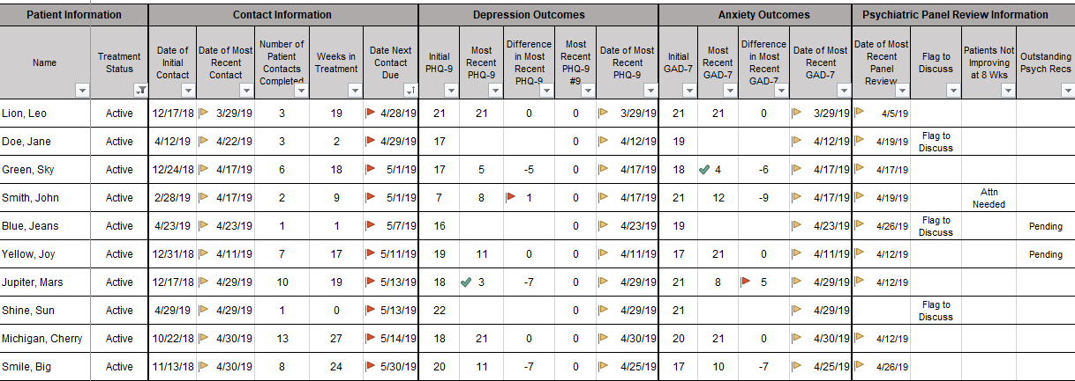
The Process of CoCM
Systematic Case Review Tool
Note: This example includes many “nice to have” components—more simplified tools will suffice.
Notes:
Presenter: Sue Vos

Slide 37
The Process of CoCM
Documentation Consideration: 21st Century Cures Act: Impact on medical documentation visibility by patients
Notes that must be shared:
Clinical notes to which the rules do not apply:
Consultation notes
Imaging narratives
Laboratory report narratives
Pathology report narratives
Procedure notes
Discharge summary notes
History and physical
Progress notes
Psychotherapy notes that are separated from the rest of the individual’s medical record and are recorded (in any medium) by a health care provider who is a mental health professional documenting or analyzing the contents of conversation during a private counseling session or a group, joint, or family counseling session.
Information compiled in reasonable anticipation of, or use in a civil, criminal or administrative action or proceeding.
Note: All clinicians and organizations are required to share medication prescription and monitoring, counseling session start and stop times, the modalities and frequencies of treatment furnished, results of clinical tests, and any summary of the following items: diagnosis, functional status, the treatment plan, symptoms, prognosis, and progress to date.
https://www.opennotes.org/onc-federal-rule/#:~:text=On%20April%205%2C%202021%2C%20federal,the%20rules%20allow%20specified%20exceptions.
Notes:
Presenter: Sue Vos

Slide 38
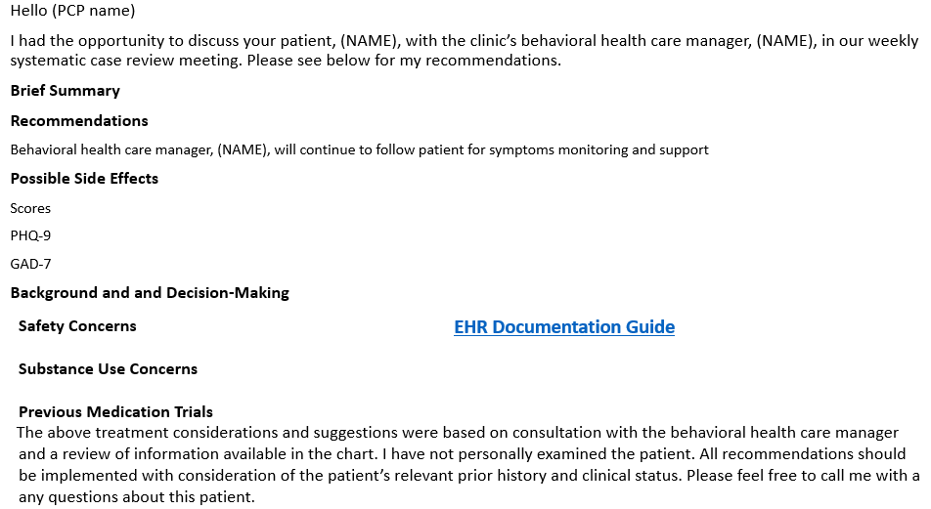
The Process of CoCM
Systematic Case Review: Standard Work Considerations Communication and Documentation
How will the Psychiatric Consultants recommendations reach the PCP?
How will the BHCM know when the PCP has reviewed the recommendations and decided about implementation?
Notes:
Presenter: Sue Vos

Slide 39
See sample in the toolkit
Notes:
Presenter Sue – Mark Williams adds input/thoughts
Display document and show examples

Slide 40

The Process of CoCM
Systematic Case Review
Demonstration Activity
Notes:
Role play: Mark and Robin

Slide 41
The Process of CoCM
Getting Started: Initial Treatment Planning
PCP: Completes medical assessment as needed, initiates appropriate treatment with BHCM, prescribes initial medication trial, provides support to patient regarding treatment and communicates with BHCM
BHCM: Provides psychoeducation about anxiety and depression, coordinates with team to create integrated treatment plan, provides brief behavioral intervention and follow-up plan
Psychiatric Consultant: Supports treatment planning and guides treatment decisions as needed, supports medication concerns
Patient: Learns about anxiety/depression and treatments options, works with team to develop a plan that reflects goals
Notes:
Presenter: Sue Vos

Slide 42
The Process of CoCM
Treatment Plan
Developed by the Care Team to include the patient
Goals have observable, measurable outcomes (SMART)
Outcomes are routinely measured
Treatment to target
Treatments are actively changed until treatment goals are achieved (treat-to-target)
Clinical outcomes are routinely measured by evidence-based tools (PHQ GAD)
Notes:
Presenter: Sue Vos

Slide 43
The Process of CoCM
Treatment Steps – Implementation and Monitoring
Initiate Treatment
Initiate treatment
Track Treatment
Follow-up contacts and progress of treatment/self-management plan
Adjust Treatment
Assess patient’s improvement as defined by PHQ-9 and GAD-7
Adjust treatment accordingly
Conclude Treatment
Relapse Prevention Planning or transition to community resources
Follow up and monitor
Review at SCR
Adjust
Assess Patient Response
Follow up and monitor
Track
PHQ/GAD
Track
PHQ/GAD
Review at SCR
Adjust
Conclude Treatment
Notes:
Presenter: Sue Vos

Slide 44
The Process of CoCM
Treat to Target and Treatment Intensification
Be prepared to adjust the treatment plan until targets are achieved (think SCR)
  Monitor patient’s progress
  Provide robust outreach to the patient
  Assess patient’s adherence throughout treatment
    Make adjustments as indicated
  Proactively seek consultation
Treat to Target has been used for medical conditions for decades (e.g., diabetes, hypertension)
Notes:
Presenter: Sue Vos – input from Mark and Robin

Slide 45

The Process of CoCM
BHCM Interventions
Using the Spirit and Concepts of Motivational Interviewing the BHCM will provide:
  Problem-Solving Treatment
  Behavioral Activation
  Medication Monitoring
  Education
Notes:
Presenter: Robin Schreur

Slide 46

The Process of CoCM
Early On: Self-Management Plan
Self-management plans are defined as: ‘structured, documented plans that are developed to support an individual patient's self-management of their condition’
The BHCM will develop a Self-Management Plan with the patient that all team members should have access to in the chart.
Example: Brenda will walk for 15 minutes in her neighborhood on Monday/Wednesday/Friday morning before work for 6 weeks.
Notes:
Presenter: Robin Schreur

Slide 47

The Process of CoCM
Self Management
Notes:
Sue – sets up video – end after 2nd provider.

Slide 48
Table 1. Components of self-management of depression
Component | Tasks
Information | Educating self and family members/friends about depression
Medication management | Taking Medications as recommended by one’s health care provider Overcoming barriers to adherence to medications
Symptom management | Using various strategies to manage symptoms of depression Self-monitoring of symptoms Managing concurrent symptoms of anxiety and/or substance use Using techniques to deal with frustration, fatigue, and isolation Relaxation Using strategies for preventing relapse of depression
Lifestyle | Exercise Overcoming barriers to exercise adherence Vacations Leisure activities Healthy nutrition and diet
Social support | Family support Relationships with peers and friends
Communication | Assertiveness Communication strategies (eg. with mental health professionals)
Others | Accessing support services Creating action plans Decision making Goal setting Problem solving Career Planning Spirituality
Duggal HS. Self-management of depression: Beyond the medical model. Perm J 2019;23:18-295. DOI: https://doi.org/10.7812/TPP/18-295
8/16/2022
This document contains confidential and proprietary information. Any further copying, reproduction, or distribution without express written consent of presenters is strictly prohibited.
48
Notes:
Presenter: Robin Schreur

Slide 49

Follow Up Process: Patient Lindsay Noham
Lindsay’s case was initially reviewed with the psychiatrist 4 weeks ago. Lindsay’s history did not indicate previous depression episodes, her PHQ-9 score was 15, and she has a BMI of 30 . The psychiatrist recommended Lindsay start on Citalopram. Citalopram is a first line anti-depressant, and related to the obesity, may have a secondary impact on decreased appetite.
There was an initial follow up at 1 week and 2 weeks to closely monitor side effects to the Citalopram.
A few side effects were noted (nausea and constipation), and the BHCM’er provided Lindsay with reassurance they would decrease, and a couple of tips to help manage the side effects.
The BHCM’er let Lindsay know she would also review the side effects with her provider and psychiatrist at the weekly review. The BHCM’er scheduled a follow up visit within a week to review the recommendations and re-assess the side effects.
The BHCM’er outreaches to Lindsay today (4 weeks post initial treatment). She greets Lindsay warmly, thanks her for taking the call and reminds Lindsay of the agenda and inquires if there is anything Lindsay would like to add.
Standing Agenda:
Complete the PHQ-9 (if over 2 weeks since last)
Review for any risk/safety issues (ER, hospital, new treatment)
Progress with the self-management action plan (focus on success)
Open - items for the patient to add
Notes:
Presenter: Robin Schreur

Slide 50
The Process of CoCM
Follow-Up: Frequency
Weekly or every other week during ACUTE PHASE
Telephone or
in-person to evaluate symptom severity
INITIAL FOCUS
Adherence to medication
Side effects of medication
Follow-up on BH interventions
LATER FOCUS
Resolution of symptoms
Long-term adherence to treatment
Follow-Up Contacts
Notes:
Presenter: Robin Schreur

Slide 51
The Process of CoCM
The CoCM Team: Follow Up and Treat to Target
PCP—Continue to prescribe medications and make treatment adjustments as needed, decide and implement treatment recommendations as appropriate, continue to review treatment plan with patient
BHCM—Provide brief behavioral interventions, monitor symptoms, update systematic case review tool, talk with patients about medication and review with psychiatric consultant
Psychiatric Consultant—review case load and prioritize those patients who are not improving, continue to provide treatment recommendations as indicated
Patient—Continue engagement with the team, follow treatment plan, complete screening measures
Notes:
Presenter: Robin Schreur

Slide 52

The Process of CoCM
Additional Considerations:
Caseload Size
Eligibility
Transitioning from CoCare
8/16/2022
This document contains confidential and proprietary information. Any further copying, reproduction, or distribution without express written consent of presenters is strictly prohibited.
52
Notes:
Presenter: Robin Schreur

Slide 53
The Process of CoCM
Caseload Size Guidelines: 1.0 BHCM FTE
Program and Patient Characteristics | Caseload Size Range
High commercial payer Mostly depression and anxiety; low clinical acuity Minimal social needs, comorbid medical conditions | 90 | 120
Commercial, public payer or uninsured Mostly depression and anxiety; few higher acuity Minimal-moderate social needs, substance use, comorbid medical conditions | 70 | 90
Public payer, uninsured, low commercial Mostly depression and anxiety; some higher acuity Minimal-moderate social needs, substance use, comorbid medical conditions | 50 | 70
Actual caseload sizes will vary by patient population and program characteristics
Notes:
Presenter: Robin Schreur

Slide 54
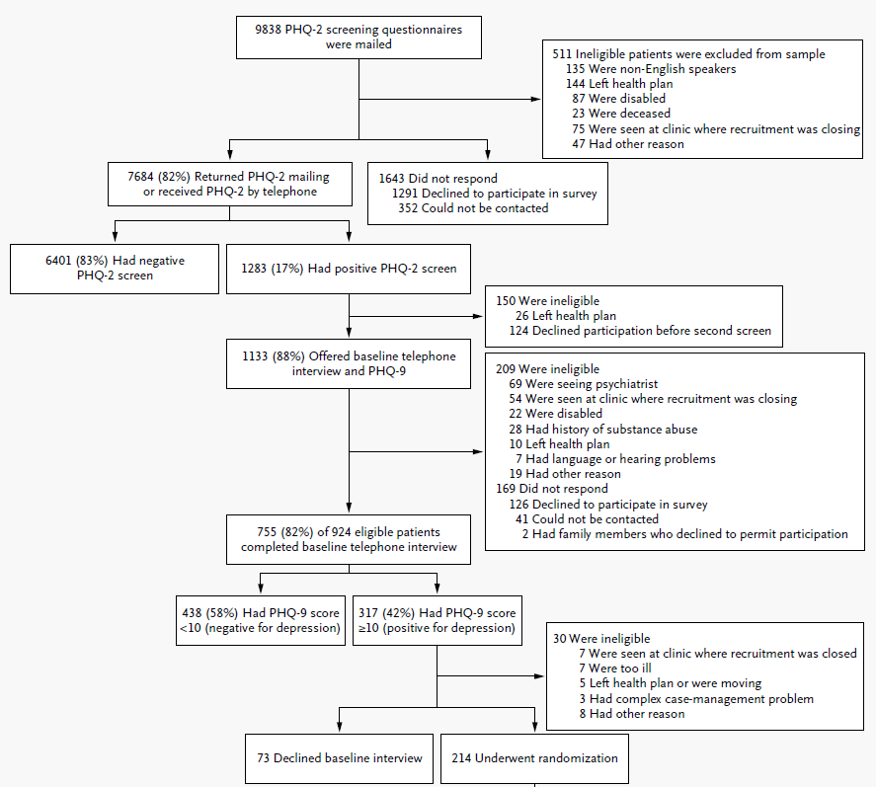
Patient Disease Registry
Ex. 1,000 patients with depression
Systematic Case Review Tool
Ex. 60 patients enrolled in CoCM
N Engl J Med 2010;363:2611-20.
8/16/2022
This document contains confidential and proprietary information. Any further copying, reproduction, or distribution without express written consent of presenters is strictly prohibited.
54
Notes:
Presenter: Robin Schreur – any added input from Dr. Williams

Slide 55

The Process of CoCM
Relapse Prevention Planning
Relapse prevention planning starts at the very beginning of CoCM
When patients reach remission, the BHCM will engage patient in reviewing and finalizing the relapse prevention planning
**We will review the elements of relapse prevention planning in CoCM training Day 2 and Day 3
Notes:
Presenter: Robin Schreur – added input from Dr. Williams

Slide 56
The Process of CoCM
Referrals Outside of CoCM
Transition to Community Resources:
  Patient not getting better
  Conditions requiring special expertise
  Conditions requiring longer-term care
  Need for recovery-based services (people with serious and persistent mental illness)
  Patient request
Notes:
Presenter: Robin Schreur – added input from Dr. Williams

Slide 57
The Process of CoCM
Recap: Team Roles
Team – starts with a team member providing the patient with the screening tool and documenting it in the patient record. Verification of payer benefit for CoCM.
PCP—recognize signs of possible diagnosis, perform/review screening tools, evaluate potential medical causes/origins of symptoms, orders labs/tests as needed, coordinate with care manager for further assessment
BHCM—complete assessment to determine appropriateness for CoCM (functional impairments, need for higher level of care, crisis management), communicates relevant info to PCP, consults with Psychiatric Consultant during systematic case review if needed for determination. Provides BI and ongoing monitoring with TTT and TI focus
Psychiatric Consultant—provide expert guidance on diagnosis as needed, assist in determining appropriate level of care
Patient—provide information about history and symptoms, complete screening tools
Notes:
Presenter: Robin Schreur – added input from Dr. Williams

Slide 58
The Process of CoCM
Team Approach
Build mutual trust
  Uphold role expectations
  Share patient success stories
One treatment plan
  Sharing clear goals with tx team and within EHR
Clarify roles and workflow
  Establish clear roles that all team members understand (through the entire practice)
  Review and update workflows as needed
Establish communication
  Develop, implement and re-evaluate communication
Notes:
Presenter: Robin Schreur – added input from Dr. Williams

Slide 59
Questions?
This document contains confidential and proprietary information. Any further copying, reproduction, or distribution without express written consent of presenters is strictly prohibited.

