Slide 1
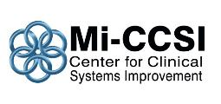
The Michigan Center for Clinical Systems Improvement welcomes you to our 3 part webinar series
March 15 – Tom Bodenhemier MD
  Maximizing Care Management; an emphasis on care/case management and health coaching
May 3 – John Fox MD & Carol Robinson DNP
  Advance Care Planning; why, how and the impact on Triple AIM
June 6 – L Gordon Moore MD
  Transforming PCMH Practices; new approaches involving measurement, accountability, and financing

Slide 2
Our speaker today
Thomas Bodenheimer MD, MPH is a general internist who received his medical degree at Harvard and completed his residency at UCSF.
He spent 32 years in full-time primary care practice in San Francisco's Mission District – 10 years in community health centers and 22 years in private practice.
He is currently Professor Emeritus of Family and Community Medicine at University of California, San Francisco and Founding Director of the Center for Excellence in Primary Care.
He is co-author of Understanding Health Policy, 7th Edition, 2016, and Improving Primary Care, 2006 (both McGraw-Hill). He has written numerous health policy articles in the New England Journal of Medicine, JAMA, Annals of Family Medicine, and Health Affairs.

Slide 3
Disclosure Statement of
Financial Interest
I, Thomas Bodenheimer MD, MPH
DO NOT have a financial interest/arrangement or affiliation with one or more organizations that could be perceived as a real or apparent conflict of interest in the context of the subject of this presentation.

Slide 4
Care management of patients with complex healthcare needs
Thomas Bodenheimer MD
Center for Excellence in Primary Care
University of California, San Francisco
Michigan Center for Clinical Systems Improvement
March 15, 2016

Slide 5
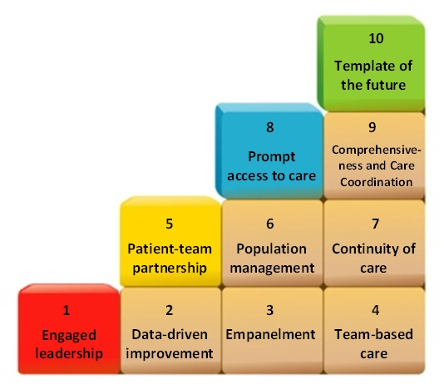
The Building Blocks of High-Performing Primary Care
Annals of Family Medicine 2014;12:166
Notes:
5
Our building blocks to high performing primary care were developed as a roadmap to guide practices during transformation. Transforming to a primary care medical home requires more than checking boxes and capturing screen shots.
I will spend the rest of the presentation discussing how the blocks were developed, the overall sequencing, practical implementation of the components of each block and showcase exemplars from high-performing sites and from other clinics that we are familiar with or coach.

Slide 6


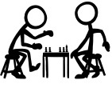









Building Block 6. Population management: stratifying the panel
Panel Management: Ensuring that ALL of the patients in our panel get recommended preventive and chronic care
Notes:
Not dependent on whether they come in for the purpose of preventive care… or even if they come in at all.
6

Slide 7
Population management: stratifying the panel
Health Coaching: Helping patients with less complex chronic conditions to improve their self-management skills.

Slide 8
Population management:
Stratifying the panel
Complex Care Management: Targeted, team-based management for patients with complex healthcare needs

Slide 9
Care coordination and care management
Care coordination ensures that
Care management assists patients/families to live with their chronic conditions through patient education, health coaching, medication management
Complex care management is team-based care management for complex patients to 1) improve health and 2) reduce the need for expensive services.
Care coordination is an important part of complex care management: making sure patients can navigate the confusing health system
Specialists, hospitals, labs, pharmacies, home care agencies – the medical neighborhood -- are available to primary care patients, and
Primary care and the medical neighborhood share information in a timely manner
Mainly done by non-licensed personnel
Requires licensed personnel

Slide 10

The confusing
health system
PCP

Slide 11
Care coordination or care management?
Referral coordinator in primary care practice checks with a health plan to see if it has approved a CT scan for a patient.
A social worker has a discussion with a high-utilizing patient about alternatives to calling 911
Spanish-speaking MA goes to specialist visit with Latino patient to translate
RN discusses alternatives to using opioids for a chronic pain patient and offers substance use referrals
MA uses a referral log to contact specialists who have not returned consultation reports to see if the patient attended the appointment and to get the report
MA health coach engages a patient to discuss medication adherence

Slide 12
Care management for patients with 1 – 2 chronic conditions
Systematic review of 41 studies of patients with diabetes: planned visits with nurse care manager was associated with improved outcomes¹
Meta-analysis of 66 studies of quality improvement strategies for patients with diabetes
The most effective strategies
Team-based care
Planned visits by nurses or pharmacists
The planned visits provide health coaching (self-management support)
Best results when RN or pharmacist (using standing orders) makes medication adjustments without awaiting physician authorization²
1. Renders et al. Diabetes Care 2001;24:1821.
2. Shojania, JAMA 2006;296:427.

Slide 13
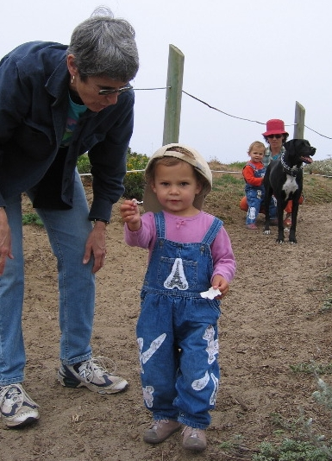
Health Coaching: Engaging Patients and Families in Their Care

Slide 14
What is health coaching
Paradigm shift:
From: Doctor (or nurse) tells patient what to do and calls them non-compliant if they don’t do it
To: Engaging patients to learn their goals and what they are willing and able to do; meeting them half-way
Health coaching assists patients to gain the knowledge, skills, and confidence to become informed, active participants in managing their chronic condition [Ghorob, Fam Pract Management, May/June 2013]
The 2 key components of care management are health coaching and medication management
Health coaching is:
1. A function everyone should do
2. A job that a few people should be trained in and have time for

Slide 15
Health Coaching Evidence
RCT: patients with diabetes, hypertension and/or hyperlipidemia with medical assistants trained as health coaches had significantly improved A1c and LDL-cholesterol compared with non-coached patients¹
In a RCT of low-income patients with poorly controlled diabetes, patients with peer health coaches (other patients with diabetes) had significantly improved A1c levels compared with controls²
1) Willard-Grace, Ann Fam Med 2015;13:130; 2) Thom et al, Ann Fam Med 2013:11:137.

Slide 16
Health coaching skills and evidence
Curriculum, tools, videos at cepc.ucsf.edu
Ask-tell-ask
Engaging patients by asking what they think and what are their goals is associated with better outcomes than telling patients what to do¹
Know your numbers
Diabetic patients who know their A1c and their A1c goal have better control than a control group²
Close the loop (teachback)
50% of patients leave the medical visit without understanding their care plan. Diabetic patients whose care team closes the loop have better A1c levels³
Counseling on medication adherence
The more actively a patient is involved, the better the adherence⁴
1) Heisler et al, JGIM 2002;17:243. 2) Levetan et al, Diabetes Care 2002;25:2. 3) Schillinger et al, Arch Intern Med 2003:163:83. 4) Osterberg, Blaschke, NEJM 2005;353:487.

Slide 17
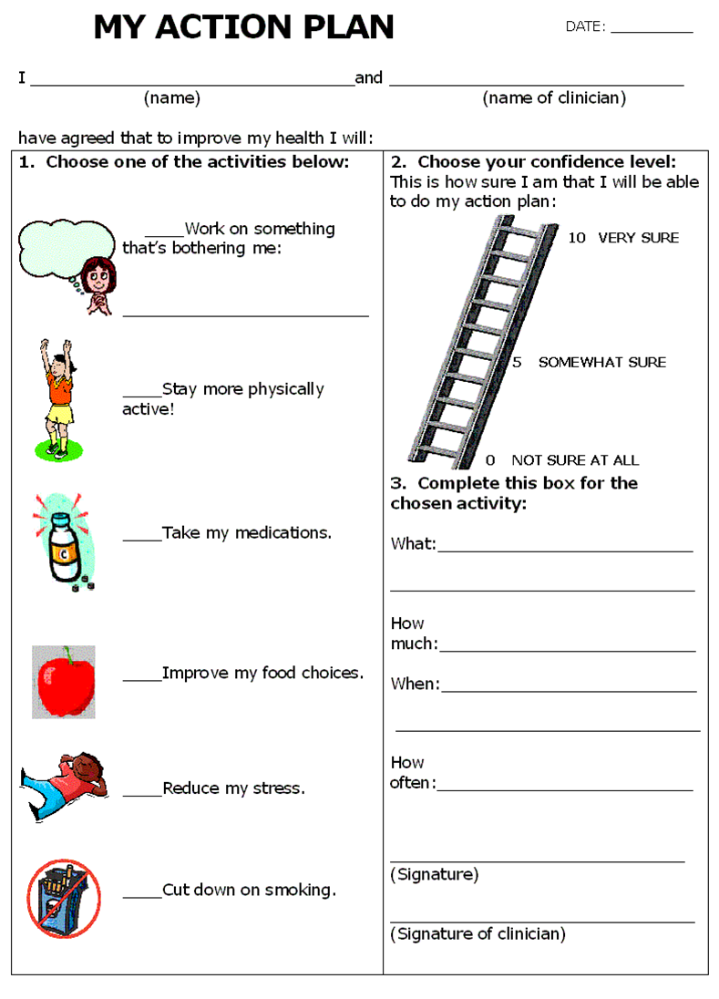
Health coaching skills and evidence: action plans
Action plans are agreements between a health coach and patient specifying a behavior change that the patient has chosen to make
Patients with diabetes randomly assigned to traditional patient education or goal- setting with action plans
The group doing action plans had significant reduction in HbA1c compared with the patient education group, whose A1c did not change
Naik et al, Arch Intern Med 2011;171:453

Slide 18
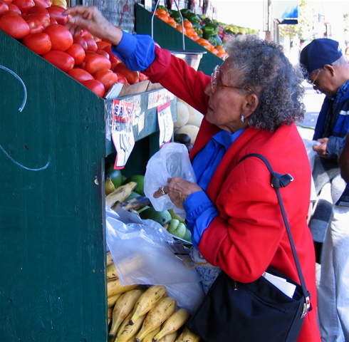
Wisdom from Kate Lorig RN, PhD
The founder of evidence-based health coaching
Stanford Patient Education Research Center
“If you are confident you can do something, you probably can do it. If you are not confident, you probably can’t.”

Slide 19
Average per capita spending by number of chronic conditions (2004)
Anderson, “Chronic conditions” Johns Hopkins, 2007

Slide 20
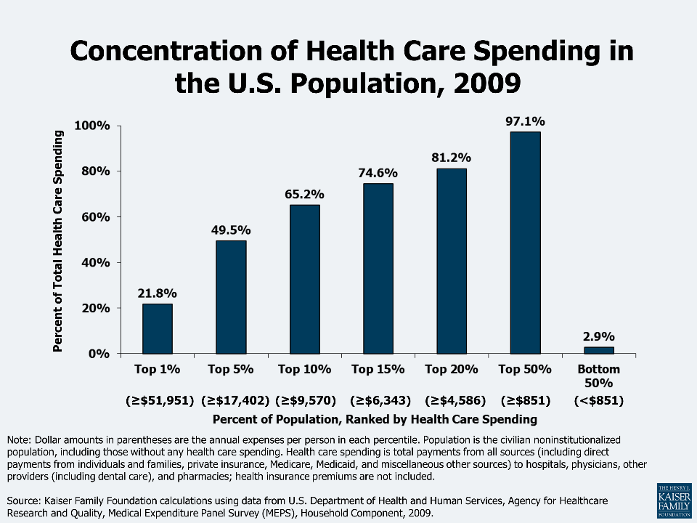

Slide 21
Complex care management
Care management for patients with complex health care needs
Who does complex care management?
Because it takes a lot of resources, who are the best patients to target?
What are the case loads?
What does the team do?
What are the goals?
Reducing total costs
Improving health and quality of life
What are some complex care management models?
RN or SW alone, about 50
RN + SW + health coach/patient navigator, perhaps 200
Team of RN, SW, pharmacist, health coach/patient navigator

Slide 22
Who needs CCM?
Most are patients with
Multiple chronic conditions
CCM is intensive, costly process requiring highly skilled personnel
It shouldn’t be offered to patients who are
Too healthy (i.e., low risk for hospitalization and excessive costs)
Frequent hospitalizations, high costs
Many prescription medications
Many care providers, requiring care coordination
Limitations of ADL
Too sick to benefit

Slide 23
How select patients for CCM?
Health plan high-risk lists (e.g. those with 2 or more hospital admits in past year, or high risk score)
Opinion of PCP and primary care team
Need both; they are never the same
After identifying patients, RN discusses with patient/family to see if they agree to engage
Hx of costs over 2-3 years, number of dx’s, number of rx’s, depression, self-mgm skills, social isolation
Hong C et al. Caring for High-Need, High-Cost Patients: What Makes for a Successful Care Management Program? Commonwealth Fund, August 2014

Slide 24
Key components of complex care management (CCM)
Team assesses what the patient needs
Team develops care plan with patient, family, physicians
Team teaches patient/family about diseases, symptoms
Team coaches patient/family on yellow flags, red flags
Team tracks how patient is doing over time, revises care plan as needed
Team uses health coaching techniques
Close the loop
Know your numbers
Medication adherence counseling
Action plans

Slide 25
Payment for complex care management
The dysfunction of fee-for-service
Pays face-to-face visits with physicians, NPs, PAs
Teams are an expense, not a revenue source
Fee-for-service add-ons
PCMH payments
Alternative payment models
Capitation
Pay-for-performance
Global budget, usually in an ACO
Shared savings from reducing hospitalizations in an ACO

Slide 26
Payment for complex care management:
Medicare’s new care management fee
CPT code 99490: physicians, NPs, PAs, clinical nurse specialists
Eligible patients: 2 or more chronic conditions that increase risk of death, exacerbation, or functional decline
Care plan: problem list, goals, symptom management, medication management, care coordination
Lots of work, fee about $45 once a month
Provider/team accessible 24/7
Many practices find the amount of work to be greater than the amount of payment
Complex care manager, 100 patients/month: $54,000.

Slide 27
Some complex care management models
Hospital Discharge Model: Transition from inpatient to home
Health Plan Model: Health plan employs CCM team, mainly telephonic
Primary Care Model: CCM team embedded in one or more primary care practices
aICU Model: All care provided by separate high-risk clinic or high-risk team, patient leaves PCP
ED Model: Emergency Department-embedded team provides CCM
Home Care Model: Care entirely in patient’s home
Housing First Model: Homeless or precariously housed people receive stable housing with social services
Community-Based Model: Care provided where patients are
Bodenheimer T, Berry-Millett R. Care Management for Patients with Complex Healthcare Needs, Robert Wood Johnson Foundation, 2009; Bodenheimer T. Strategies to Reduce Costs and Improve Care for High-Utilizing Medicaid Patients: Reflections on Pioneering Programs. Center for Health Care Strategies, October 2013.

Slide 28
Health plan model:
CareOregon Medicaid managed care plan
Health resilience specialists are hired by the health plan and embedded in primary care practices
Masters degree in social work or psychology
Experience in community work and addiction
Most patients have 3 issues
Physical disease (COPD, CHF, HBP, diabetes
Mental health issues
Patients seen in clinic, at home, in community settings; are accompanied to specialist and community referral sites. Not just telephonic care management
In addition to building trust, the health resilience specialists
Help navigate health and social service systems
Addiction, mostly opioids and alcohol
Motivational interviewing
Health literacy education
Self-management skill development
Supervised by RN, behaviorist, pharmacist
All meet weekly for to discuss difficult cases

Slide 29
Hospital discharge model:
Care Transitions Intervention
Coleman et al, Arch Intern Med 2006;166:1822
RNs trained as “transition coaches” to teach patients/families skills to care for themselves
1 hospital visit, 1 home visit post-discharge, 3 post-discharge phone calls
Significantly lower readmission rates and lower hospital costs compared with controls

Slide 30

Primary care model: patients stay with PCP
Geriatric Resources for Assessment and Care of Elders (GRACE)
Counsell et al, JAMA 2007;298:2623
NP/SW care management team working with PCPs and geriatrician
In-clinic, home and phone contacts
Extensive training of care management team
Small case load for care management team
Higher-risk subgroup: lower ED/hospitalization rates year 2, lower total costs year 3 compared with controls

Slide 31
Ambulatory intensive caring unit (aICU) model
Complex patients cared for by separate high-risk clinic (aICU) with a team of physician, RN, SW, perhaps pharmacist, health coaches
Primary care physicians often happy that complex patients leave for the aICU because these patients take a lot of time
If patients have PCP, they leave PCP; most are satisfied because the aICU provides much more care and is accessible
Rather than a separate aICU there might be a
high-risk team in the primary care practice;
patients leave their PCP to be on that team

Slide 32
aICU hybrid
Separate clinic/team with CCM team including physician
Patient’s PCP
RN-led CCM team
+
Hybrid: patients choose CCM in aICU or stay with PCP
Keep PCP
Leave PCP
Patient chooses
aICU RN spends part-time at aICU and part-time care-managing patients in primary care

Slide 33
aICU hybrid model:
Stanford Coordinated Care
Separate clinic only for complex patients
Patients can choose to stay with PCP or leave PCP and receive all care at Stanford Coordinated Care
RN goes to practices of patients keeping their PCP
Care coordinators are health coaches, join visit as scribe, post-visit and between-visit to ensure understanding, set goals, teach yellow/red flags, help patients navigate the system, go with patients to specialists
aICU team is 3 MDs, RN, LCSW, pharmacist, physical therapist/chronic pain expert, 3 care coordinators

Slide 34
aICU hybrid model:
Stanford Coordinated Care
Multiple clinical measures (like A1c, BP), functional measures (ADLs), utilization measures (ED visits, admits), and patient experience measures
Metrics on big wall chart with red/yellow/green dots (red=bad, green=good). Goal: “get the red out”
CCM team meets to discuss patients, see if improvement or not on the red/yellow/green wall chart
Early data: ED visits down 39%, hospital admits down 25%. Patient and staff satisfaction 99%, HEDIS quality measures 99th percentile

Slide 35
Across all these programs, what works?
Most critical is health coaching: teaching patients/families/caregivers how to self-manage their conditions

Slide 36
Health coaching for complex patients
When you separate out the problems of a complex patients, each problem is not so complicated; complexity is the interaction of multiple problems. A care plan and action plan can be created for each of the separate problems
Coaching of complex patients is both similar and different from coaching of less complicated patients
Example:
Diabetes: care plan is lifestyle change and titrating medications
Osteoarthritis: care plan is physical therapy, exercise program, anti-inflammatory medications
Domestic violence: meet with social worker to make definitive care plan

Slide 37
Health coaching for complex patients
Reducing hospitalizations is both a cost outcome and a quality outcome
Best way to reduce hospitalizations is teaching yellow and red flags. Example CHF: increased shortness of breath, edema, or 3 pound weight gain are yellow flags. Coaching teaches
3) Take medications faithfully
1) weigh yourself daily and if weight up 3 pounds, call care team or take extra furosemide
2) Reduce salt intake

Slide 38
Take-home messages
Population-based care includes
Panel management
Health coaching assists patients to gain the knowledge, skills, and confidence to become informed, active participants in their care
Health coaching is essential for all patients with chronic conditions
Gradually, we are learning from experience how to care for patients with high costs and complex healthcare needs
Health coaching
Complex care management
Care management includes patient education, health coaching and medication management
Patients with 1 or 2 conditions
Patients with multiple conditions and complex healthcare needs

Slide 39

Thank you for improving health care for the people of Michigan

Slide 40
Reminder
CME and SW CE
  To obtain your continued education credits please complete and return the evaluation form emailed to you
  Include your name in the attestation request on the form
  Return the form to Kristen.gildner@miccsi.org or fax to 616.608.4058
  If you did not receive the evaluation please email Kristen at the email address above.

